Slide 1
Language Modeling
Introduction to N-grams
Notes:
Generally speaking, a model (in the statistical sense of course) is a mathematical representation of a process.
Almost always models are an approximation of the process.
A statistician guy once said: All models are wrong, but some are useful.
What it does?: it describes how the modelled process (human language) creates data.

Slide 2
Probabilistic Language Models
Today’s goal: assign a probability to a sentence
Machine Translation:
P(high winds tonight) > P(large winds tonight)
Spell Correction
The office is about fifteen minuets from my house
P(about fifteen minutes from) > P(about fifteen minuets from)
Speech Recognition
P(I saw a van) >> P(eyes awe of an)
+ Summarization, question-answering, etc., etc.!!
Why?
Notes:
minuets: a slow, stately ballroom dance for two in triple time, popular especially in the 18th century.

Slide 3
Probabilistic Language Modeling
Goal: compute the probability of a sentence or sequence of words:
P(W) = P(w₁,w₂,w₃,w₄,w₅…w_{n})
Related task: probability of an upcoming word:
P(w₅|w₁,w₂,w₃,w₄)
A model that computes either of these:
P(W) or P(w_{n}|w₁,w₂…w_{n-1}) is called a language model.
Better: the grammar But language model or LM is standard

Slide 4
How to compute P(W)
How to compute this joint probability:
P(its, water, is, so, transparent, that)
Intuition: let’s rely on the Chain Rule of Probability

Slide 5
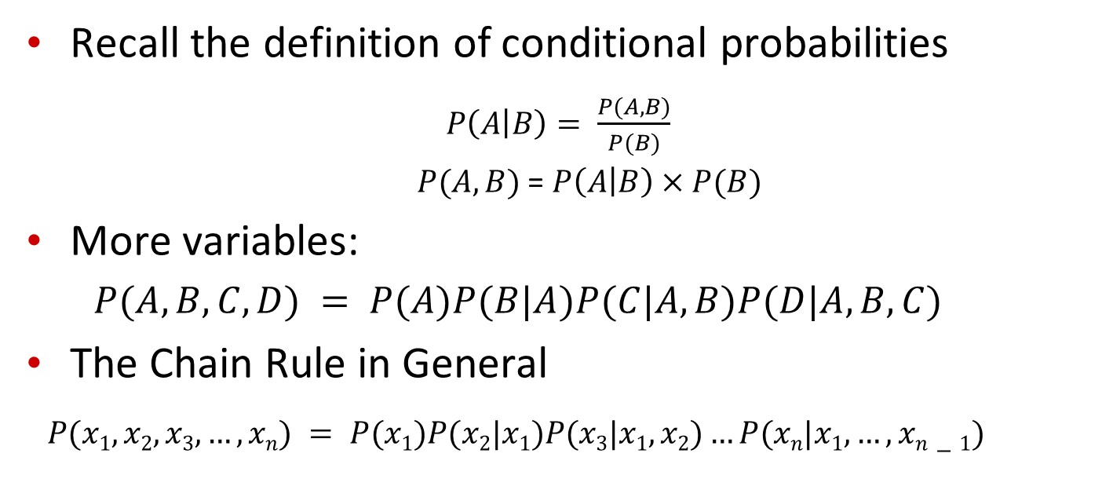
Reminder: The Chain Rule
Recall the definition of conditional probabilities
$P\left(A | B\right)= \frac{P(A,B)}{P(B)}$
$P(A,B)$ = $P\left(A | B\right)×P(B)$
More variables:
$P(A,B,C,D) = P(A)P(B|A)P(C|A,B)P(D|A,B,C)$
The Chain Rule in General
$P(x1,x2,x3,…,xn) = P(x1)P(x2|x1)P(x3|x1,x2)…P(xn|x1,…,xn−1)$

Slide 6
The Chain Rule applied to compute joint probability of words in sentence
P(“its water is so transparent”) =
P(its) × P(water|its) × P(is|its water)
× P(so|its water is) × P(transparent|its water is so)

Slide 7
How to estimate these probabilities
Could we just count and divide?
No! Too many possible sentences!
We’ll never see enough data for estimating these

Slide 8
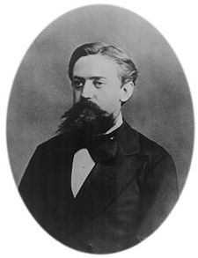
Markov Assumption
Simplifying assumption:
Or maybe
Andrei Markov

Slide 9
Markov Assumption
In other words, we approximate each component in the product

Slide 10
Simplest case: Unigram model
Some automatically generated sentences from a unigram model
fifth, an, of, futures, the, an, incorporated, a, a, the, inflation, most, dollars, quarter, in, is, mass
thrift, did, eighty, said, hard, 'm, july, bullish
that, or, limited, the
Notes:
Bag of words

Slide 11
Bigram model
Condition on the previous word:
texaco, rose, one, in, this, issue, is, pursuing, growth, in, a, boiler, house, said, mr., gurria, mexico, 's, motion, control, proposal, without, permission, from, five, hundred, fifty, five, yen
outside, new, car, parking, lot, of, the, agreement, reached
this, would, be, a, record, november

Slide 12
N-gram models
We can extend to trigrams, 4-grams, 5-grams
In general this is an insufficient model of language
because language has long-distance dependencies:
“The computer which I had just put into the machine room on the fifth floor crashed.”
But we can often get away with N-gram models
Notes:
Try to predict crashed
It depends on computer

Slide 13
Language Modeling
Introduction to N-grams

Slide 14
Language Modeling
Estimating N-gram Probabilities

Slide 15
Estimating bigram probabilities
The Maximum Likelihood Estimate

Slide 16

An example
<s> I am Sam </s>
<s> Sam I am </s>
<s> I do not like green eggs and ham </s>

Slide 17
More examples: Berkeley Restaurant Project sentences
can you tell me about any good cantonese restaurants close by
mid priced thai food is what i’m looking for
tell me about chez panisse
can you give me a listing of the kinds of food that are available
i’m looking for a good place to eat breakfast
when is caffe venezia open during the day

Slide 18
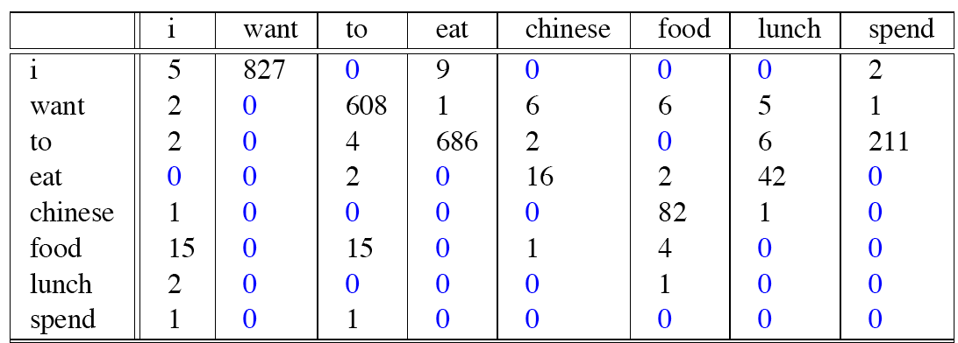
Raw bigram counts
Out of 9222 sentences

Slide 19
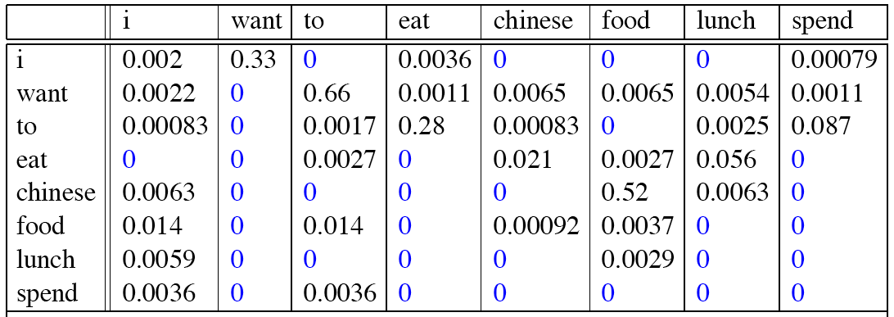
Raw bigram probabilities
Normalize by unigrams:
Result:

Slide 20
Bigram estimates of sentence probabilities
P(<s> I want english food </s>) =
P(I|<s>)
× P(want|I)
× P(english|want)
× P(food|english)
× P(</s>|food)
= .000031

Slide 21
What kinds of knowledge?
P(english|want) = .0011
P(chinese|want) = .0065
P(to|want) = .66
P(eat | to) = .28
P(food | to) = 0
P(want | spend) = 0
P (i | <s>) = .25
Notes:
English more probable than Chinese: fact about the world
Grammatical fact: want to
Spend want ungrammatical
rarely observed : to food (never came)
https://www.youtube.com/watch?v=paCMAZ-lKq8&list=PLQiyVNMpDLKnZYBTUOlSI9mi9wAErFtFm&index=13

Slide 22
Practical Issues
We do everything in log space
Avoid underflow
(also adding is faster than multiplying)

Slide 23
Language Modeling Toolkits
SRILM
http://www.speech.sri.com/projects/srilm/

Slide 24
Google N-Gram Release, August 2006
…
Notes:
Corps
Trillion word

Slide 25
Google N-Gram Release
serve as the incoming 92
serve as the incubator 99
serve as the independent 794
serve as the index 223
serve as the indication 72
serve as the indicator 120
serve as the indicators 45
serve as the indispensable 111
serve as the indispensible 40
serve as the individual 234
http://googleresearch.blogspot.com/2006/08/all-our-n-gram-are-belong-to-you.html

Slide 26
Google Book N-grams
http://ngrams.googlelabs.com/

Slide 27
Language Modeling
Estimating N-gram Probabilities

Slide 28
Language Modeling
Evaluation and Perplexity

Slide 29
Evaluation: How good is our model?
Does our language model prefer good sentences to bad ones?
Assign higher probability to “real” or “frequently observed” sentences
Than “ungrammatical” or “rarely observed” sentences?
We train parameters of our model on a training set.
We test the model’s performance on data we haven’t seen.
A test set is an unseen dataset that is different from our training set, totally unused.
An evaluation metric tells us how well our model does on the test set.

Slide 30
Extrinsic evaluation of N-gram models
Best evaluation for comparing models A and B
Put each model in a task
spelling corrector, speech recognizer, MT system
Run the task, get an accuracy for A and for B
How many misspelled words corrected properly
How many words translated correctly
Compare accuracy for A and B
Notes:
external

Slide 31
Difficulty of extrinsic (in-vivo) evaluation of N-gram models
Extrinsic evaluation
Time-consuming; can take days or weeks
So
Sometimes use intrinsic evaluation: perplexity
Bad approximation
unless the test data looks just like the training data
So generally only useful in pilot experiments
But is helpful to think about.
Notes:
حيرة

Slide 32
Intuition of Perplexity
mushrooms 0.1
pepperoni 0.1
anchovies 0.01
….
fried rice 0.0001
….
and 1e-100
The Shannon Game:
How well can we predict the next word?
Unigrams are terrible at this game. (Why?)
A better model of a text
is one which assigns a higher probability to the word that actually occurs
I always order pizza with cheese and ____
The 33rd President of the US was ____
I saw a ____
Notes:
The 33rd President of the US was … jfk or kenedy or john
It is hard to predict I saw a …. Anything could come after it

Slide 33
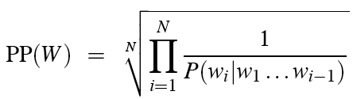
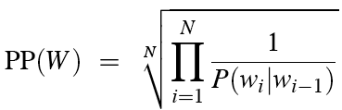
Perplexity
The best language model is one that best predicts an unseen test set
Gives the highest P(sentence)
Perplexity is the inverse probability of the test set, normalized by the number of words:
Chain rule:
For bigrams:
Minimizing perplexity is the same as maximizing probability
Notes:
Normalizing because: Longer sentences are less probable
So we can predict senenteces with different length

Slide 34
The Shannon Game intuition for perplexity
From Josh Goodman
How hard is the task of recognizing digits ‘0,1,2,3,4,5,6,7,8,9’
Perplexity 10
How hard is recognizing (30,000) names at Microsoft.
Perplexity = 30,000
If a system has to recognize
Operator (1 in 4)
Sales (1 in 4)
Technical Support (1 in 4)
30,000 names (1 in 120,000 each)
Perplexity is 53
Perplexity is weighted equivalent branching factor
Notes:
Perplexity depends on average branching factor

Slide 35
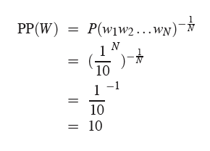
Perplexity as branching factor
Let’s suppose a sentence consisting of random digits
What is the perplexity of this sentence according to a model that assign P=1/10 to each digit?

Slide 36
Lower perplexity = better model
Training 38 million words, test 1.5 million words, WSJ
N-gram Order | Unigram | Bigram | Trigram
Perplexity | 962 | 170 | 109

Slide 37
Language Modeling
Evaluation and Perplexity

Slide 38
Language Modeling
Generalization and zeros

Slide 39
The Shannon Visualization Method
Choose a random bigram
(<s>, w) according to its probability
Now choose a random bigram (w, x) according to its probability
And so on until we choose </s>
Then string the words together
<s> I
I want
want to
to eat
eat Chinese
Chinese food
food </s>
I want to eat Chinese food

Slide 40
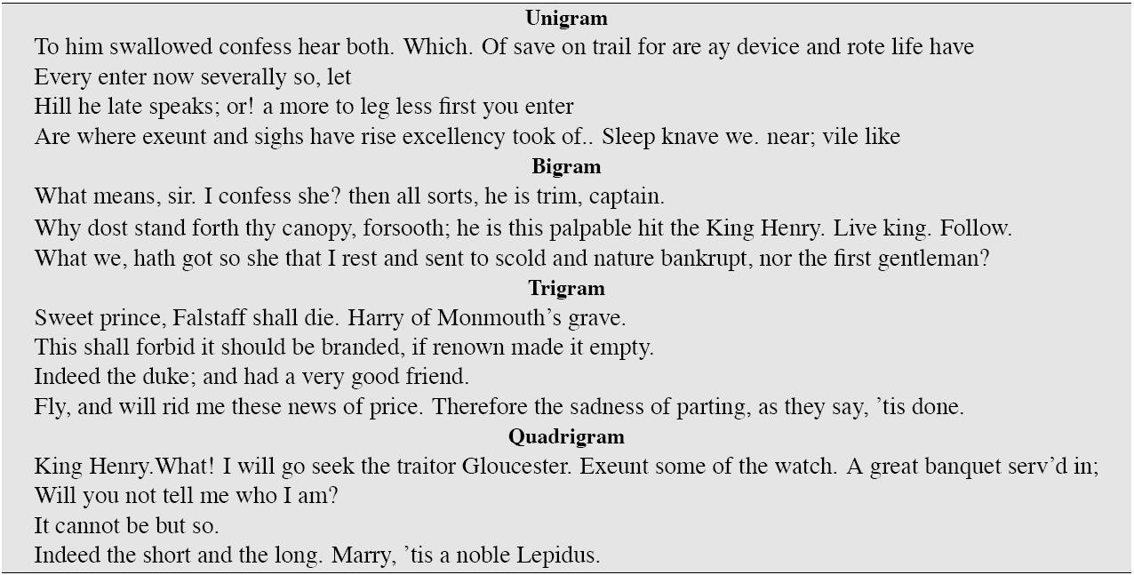
Approximating Shakespeare

Slide 41
Shakespeare as corpus
N=884,647 tokens, V=29,066
Shakespeare produced 300,000 bigram types out of V²= 844 million possible bigrams.
So 99.96% of the possible bigrams were never seen (have zero entries in the table)
Quadrigrams worse: What's coming out looks like Shakespeare because it is Shakespeare

Slide 42
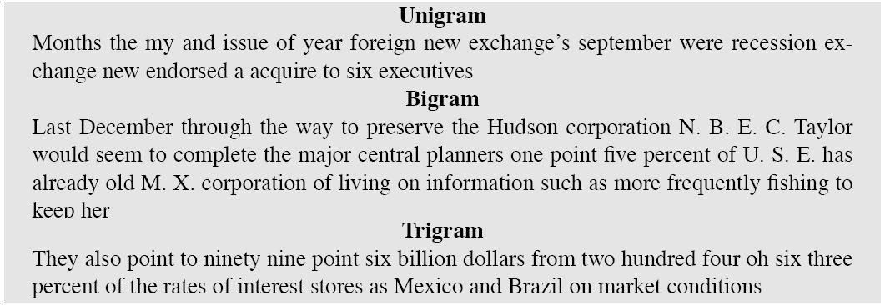
The wall street journal is not shakespeare (no offense)

Slide 43
The perils of overfitting
N-grams only work well for word prediction if the test corpus looks like the training corpus
In real life, it often doesn’t
We need to train robust models that generalize!
One kind of generalization: Zeros!
Things that don’t ever occur in the training set
But occur in the test set
Notes:
If you train in wsj and test on shekspere it doesn’t work

Slide 44
Zeros
Training set:
… denied the allegations
… denied the reports
… denied the claims
… denied the request
P(“offer” | denied the) = 0
Test set
… denied the offer
… denied the loan
Notes:
Probability based on maximum likelihood estimation
Problem we need to solve

Slide 45
Zero probability bigrams
Bigrams with zero probability
mean that we will assign 0 probability to the test set!
And hence we cannot compute perplexity (can’t divide by 0)!

Slide 46
Language Modeling
Generalization and zeros

Slide 47
Language Modeling
Smoothing: Add-one (Laplace) smoothing

Slide 48
The intuition of smoothing (from Dan Klein)
When we have sparse statistics:
Steal probability mass to generalize better
P(w | denied the)
3 allegations
2 reports
1 claims
1 request
7 total
allegations
attack
man
reports
outcome
…
claims
request
P(w | denied the)
2.5 allegations
1.5 reports
0.5 claims
0.5 request
2 other
7 total
allegations
allegations
attack
man
outcome
reports
…
claims
request
Notes:
Denied the effort

Slide 49
Add-one estimation
Also called Laplace smoothing
Pretend we saw each word one more time than we did
Just add one to all the counts!
MLE estimate:
Add-1 estimate:

Slide 50
Maximum Likelihood Estimates
The maximum likelihood estimate
of some parameter of a model M from a training set T
maximizes the likelihood of the training set T given the model M
Suppose the word “bagel” occurs 400 times in a corpus of a million words
What is the probability that a random word from some other text will be “bagel”?
MLE estimate is 400/1,000,000 = .0004
This may be a bad estimate for some other corpus
But it is the estimate that makes it most likely that “bagel” will occur 400 times in a million word corpus.
Notes:
So we are maximizing the likelihood of our training data
Add 1 smoothing is not maximum likelihood estimator: because we are changing the counts from what we had on training data

Slide 51
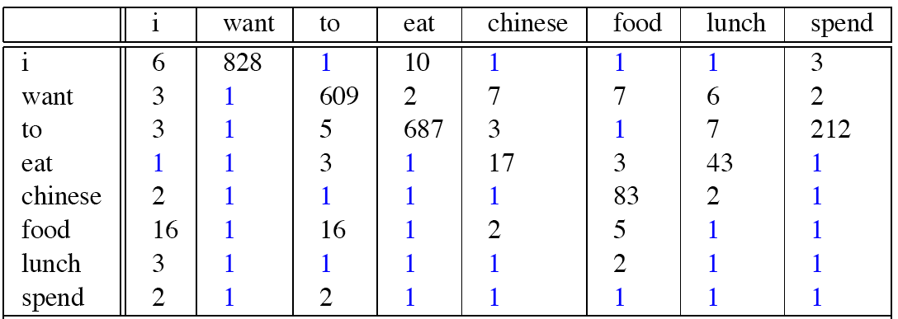
Berkeley Restaurant Corpus: Laplace smoothed bigram counts

Slide 52

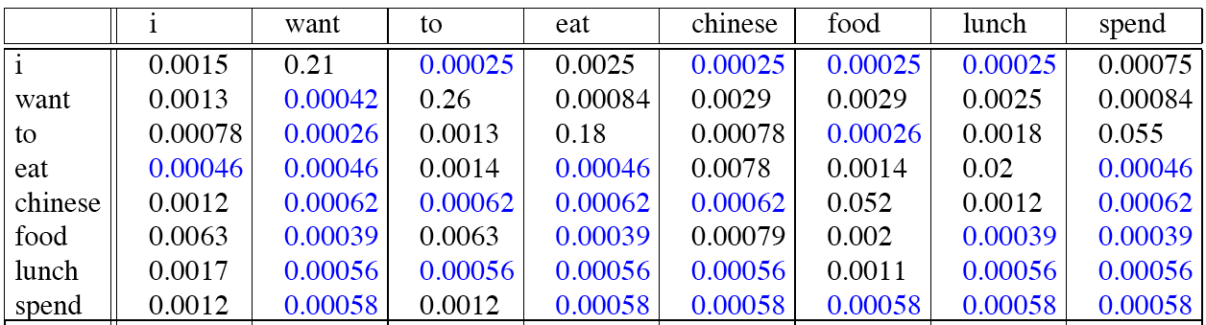
Laplace-smoothed bigrams

Slide 53
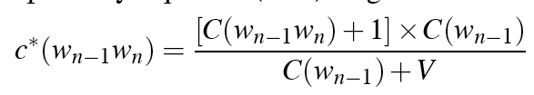
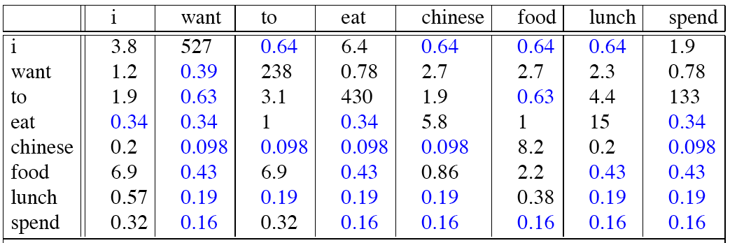
Reconstituted counts
Notes:
Take the probabilities an reestimate the counts

Slide 54
Compare with raw bigram counts
Notes:
Huge changes
C(want to) went from 608 to 238, P(to|want) from .66 to .26!
Discount d= c*/c
d for “chinese food” =.10!!! A 10x reduction

Slide 55
Add-1 estimation is a blunt instrument
So add-1 isn’t used for N-grams:
We’ll see better methods
But add-1 is used to smooth other NLP models
For text classification
In domains where the number of zeros isn’t so huge.
Notes:
حاد

Slide 56
Language Modeling
Smoothing: Add-one (Laplace) smoothing

Slide 57
Language Modeling
, Backoff, and Web-Scale LMs

Slide 58
Backoff and Interpolation
Sometimes it helps to use less context
Condition on less context for contexts you haven’t learned much about
Backoff:
use trigram if you have good evidence,
otherwise bigram, otherwise unigram
Interpolation:
mix unigram, bigram, trigram
Interpolation works better
Notes:
Mabey you don’t have a large count for trigram, we don’t’ trust it
Backoff to bigram and unigram

Slide 59
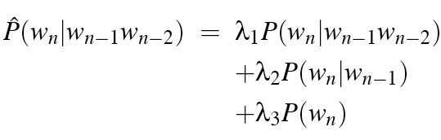

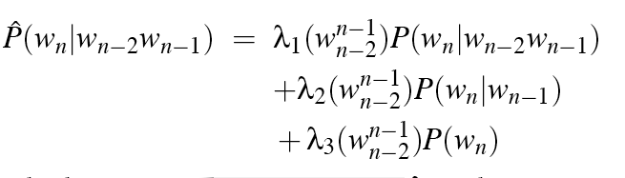
Linear Interpolation
Simple interpolation
Lambdas conditional on context:
Notes:
e.g. Lambdas conditional on the previous two words

Slide 60
How to set the lambdas?
Use a held-out corpus
Choose λs to maximize the probability of held-out data:
Fix the N-gram probabilities (on the training data)
Then search for λs that give largest probability to held-out set:
Training Data
Held-Out Data
Test
Data
Notes:
Find lambdas such that the log probability is highest

Slide 61
Unknown words: Open versus closed vocabulary tasks
If we know all the words in advanced
Vocabulary V is fixed
Closed vocabulary task
Often we don’t know this
Out Of Vocabulary = OOV words
Open vocabulary task
Instead: create an unknown word token <UNK>
Training of <UNK> probabilities
Create a fixed lexicon L of size V
At text normalization phase, any training word not in L changed to <UNK>
Now we train its probabilities like a normal word
At decoding time
If text input: Use UNK probabilities for any word not in training
Notes:
Hold out very rare words and make them unk

Slide 62
Huge web-scale n-grams
How to deal with, e.g., Google N-gram corpus
Pruning
Only store N-grams with count > threshold.
Remove singletons of higher-order n-grams
Entropy-based pruning
Efficiency
Efficient data structures like tries
Bloom filters: approximate language models
Store words as indexes, not strings
Use Huffman coding to fit large numbers of words into two bytes
Quantize probabilities (4-8 bits instead of 8-byte float)
Notes:
Compute the entropy and remove counts that contributed less

Slide 63
Smoothing for Web-scale N-grams
“Stupid backoff” (Brants et al. 2007)
No discounting, just use relative frequencies
Notes:
e.g. If trigram is available used, otherwise Just back-off to bigram multiplied by 0.4
It does not sum to 1 … it is not probability
It produces scores rather than probability

Slide 64
N-gram Smoothing Summary
Add-1 smoothing:
OK for text categorization, not for language modeling
The most commonly used method:
Extended Interpolated Kneser-Ney
For very large N-grams like the Web:
Stupid backoff

Slide 65
Advanced Language Modeling
Discriminative models:
choose n-gram weights to improve a task, not to fit the training set
Parsing-based models
Caching Models
Recently used words are more likely to appear
These perform very poorly for speech recognition (why?)

Slide 66
Language Modeling
Interpolation, Backoff, and Web-Scale LMs

Slide 67
Language Modeling
Advanced: Good Turing Smoothing

Slide 68
Reminder: Add-1 (Laplace) Smoothing

Slide 69
More general formulations: Add-k

Slide 70
Unigram prior smoothing

Slide 71
Advanced smoothing algorithms
Intuition used by many smoothing algorithms
Good-Turing
Kneser-Ney
Witten-Bell
Use the count of things we’ve seen once
to help estimate the count of things we’ve never seen

Slide 72
Notation: N_{c} = Frequency of frequency c
N_{c} = the count of things we’ve seen c times
Sam I am I am Sam I do not eat
I 3
sam 2
am 2
do 1
not 1
eat 1
N₁ = 3
N₂ = 2
N₃ = 1

Slide 73
Good-Turing smoothing intuition
You are fishing (a scenario from Josh Goodman), and caught:
10 carp, 3 perch, 2 whitefish, 1 trout, 1 salmon, 1 eel = 18 fish
How likely is it that next species is trout?
1/18
How likely is it that next species is new (i.e. catfish or bass)
Let’s use our estimate of things-we-saw-once to estimate the new things.
3/18 (because N₁=3)
Assuming so, how likely is it that next species is trout?
Must be less than 1/18
How to estimate?

Slide 74
Good Turing calculations
Unseen (bass or catfish)
c = 0:
MLE p = 0/18 = 0
P*_{GT} (unseen) = N₁/N = 3/18
Seen once (trout)
c = 1
MLE p = 1/18
C*(trout) = 2 * N2/N1
= 2 * 1/3
= 2/3
P*_{GT}(trout) = 2/3 / 18 = 1/27

Slide 75
Ney et al.’s Good Turing Intuition
H. Ney, U. Essen, and R. Kneser, 1995. On the estimation of 'small' probabilities by leaving-one-out. IEEE Trans. PAMI. 17:12,1202-1212
Held-out words:

Slide 76
Ney et al. Good Turing Intuition (slide from Dan Klein)
Training
Held out
N₁
N₀
Intuition from leave-one-out validation
Take each of the c training words out in turn
c training sets of size c–1, held-out of size 1
What fraction of held-out words are unseen in training?
N₁/c
What fraction of held-out words are seen k times in training?
(k+1)N_{k+1}/c
So in the future we expect (k+1)N_{k+1}/c of the words to be those with training count k
There are N_{k} words with training count k
Each should occur with probability:
(k+1)N_{k+1}/c/N_{k}
…or expected count:
N₂
N₁
N₃
N₂
. . . .
. . . .
N₃₅₁₁
N₃₅₁₀
N₄₄₁₇
N₄₄₁₆

Slide 77
Good-Turing complications (slide from Dan Klein)
Problem: what about “the”? (say c=4417)
For small k, N_{k} > N_{k+1}
For large k, too jumpy, zeros wreck estimates
Simple Good-Turing [Gale and Sampson]: replace empirical N_{k} with a best-fit power law once counts get unreliable
N₁
N₂
N₃
N₁
N₂

Slide 78
Resulting Good-Turing numbers
Numbers from Church and Gale (1991)
22 million words of AP Newswire
Count c | Good Turing c*
0 | .0000270
1 | 0.446
2 | 1.26
3 | 2.24
4 | 3.24
5 | 4.22
6 | 5.19
7 | 6.21
8 | 7.24
9 | 8.25

Slide 79
Language Modeling
Advanced: Good Turing Smoothing

Slide 80
Language Modeling
Advanced:
Kneser-Ney Smoothing

Slide 81
Resulting Good-Turing numbers
Numbers from Church and Gale (1991)
22 million words of AP Newswire
It sure looks like c* = (c - .75)
Count c | Good Turing c*
0 | .0000270
1 | 0.446
2 | 1.26
3 | 2.24
4 | 3.24
5 | 4.22
6 | 5.19
7 | 6.21
8 | 7.24
9 | 8.25

Slide 82
Absolute Discounting Interpolation
Save ourselves some time and just subtract 0.75 (or some d)!
(Maybe keeping a couple extra values of d for counts 1 and 2)
But should we really just use the regular unigram P(w)?
discounted bigram
Interpolation weight
unigram

Slide 83
Kneser-Ney Smoothing I
Better estimate for probabilities of lower-order unigrams!
Shannon game: I can’t see without my reading___________?
“Francisco” is more common than “glasses”
… but “Francisco” always follows “San”
The unigram is useful exactly when we haven’t seen this bigram!
Instead of P(w): “How likely is w”
P_{continuation}(w): “How likely is w to appear as a novel continuation?
For each word, count the number of bigram types it completes
Every bigram type was a novel continuation the first time it was seen
Francisco
glasses

Slide 84
Kneser-Ney Smoothing II
How many times does w appear as a novel continuation:
Normalized by the total number of word bigram types

Slide 85
Kneser-Ney Smoothing III
Alternative metaphor: The number of # of word types seen to precede w
normalized by the # of words preceding all words:
A frequent word (Francisco) occurring in only one context (San) will have a low continuation probability

Slide 86
Kneser-Ney Smoothing IV
λ is a normalizing constant; the probability mass we’ve discounted
The number of word types that can follow w_{i-1}
= # of word types we discounted
= # of times we applied normalized discount
the normalized discount

Slide 87
Kneser-Ney Smoothing: Recursive formulation
Continuation count = Number of unique single word contexts for •

Slide 88
Language Modeling
Advanced:
Kneser-Ney Smoothing

